Slide 1
School Test Coordinators
Presented by:
Dr. Cynthia Pritchett
November 12, 2015
Notes:
This is a presentation of the most up to date information as of Thursday, November 12th.

Slide 2
What are the primary objectives of the PARCC Assessment System?
Determine whether students are college- and career-ready or “on track”
Provide tools to assess student learning and support instruction during the school year
Report growth in performance as well as absolute achievement
Report comparable results across schools, districts and member states
Generate valid and reliable information to inform instruction and accountability decisions
Use technology for a range of purposes including increasing student access, providing accommodations, engaging students, and creating efficiencies in administration, scoring and reporting
Notes:
Remember that the PARCC test is different than any other previous testing and not just because it is given in a digital format. Previous testing has been solely based on each students’ ability to show their knowledge of NJ state standards. PARCC testing assesses student knowledge AND understanding of the NJ state standards to determine students’ readiness for “college and career.”

Slide 3
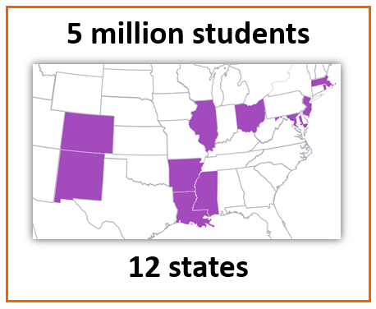
Test Administration in 2015
Key Stats
1.2 million students in one day
204,000 students in one hour
Peak: 1million testers per day x 5 days
Thousands of hours contributed by thousands of educators to develop the test
Notes:
At first glance, having only 12 participating states looks like something must be “wrong” with PARCC, why aren’t more states on board? PARCC started with 23 states. What happened? Remember: first, these 12 states (the PARCC test) assesses more students (5 million) than any other single test out there making the PARCC data more valid than any other test—more valid than NJASK data ever was, because with NJASK, we only had our own state to compare scores with. Second, the stakes are high for whatever “company” takes the contract for testing. With PARCC testing, our state (NJ) is on the governing board for development. We have a seat at this table, which gives us the ability to develop the test the way we want it to be. That is why when we said the test was too long—the test was changed. If we were to move to a different test, we would give up that ability.

Slide 4
Changes for 2016

Slide 5
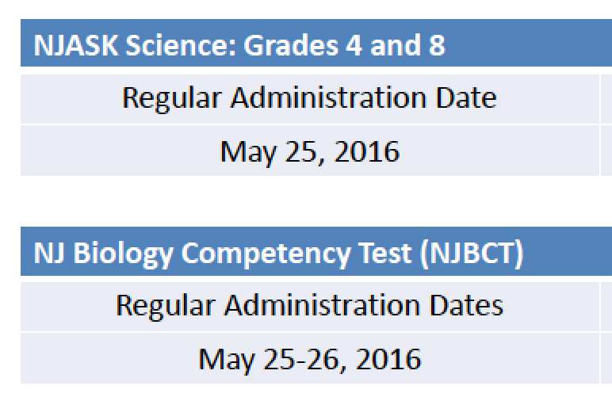
The New Jersey Window
Note: AP Exams to occur May 2-13
Notes:
The first change are the testing dates. Grades 3-8 are testing between April 4th and May 13th. The High School will be testing from April 11th - May 20th. However, we (as a district) are off from April 11-15th. The bad news is that not only do we lose a week, but the high school will return from Spring Break to a testing environment. The good news is, we will only be testing for 25 days (at most) instead of 30 (including make-up exams).

Slide 6
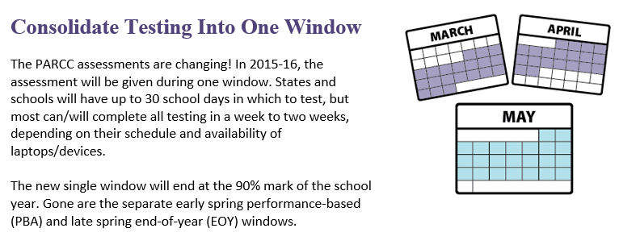
Test Design Changes – One Testing Window
Notes:
There are no more PBA and EOY tests. There is only one testing window—One test administration. Although we have one less week to test, and we will have to be creative with scheduling, it should not take any more than two weeks to test students (including makeups).

Slide 7
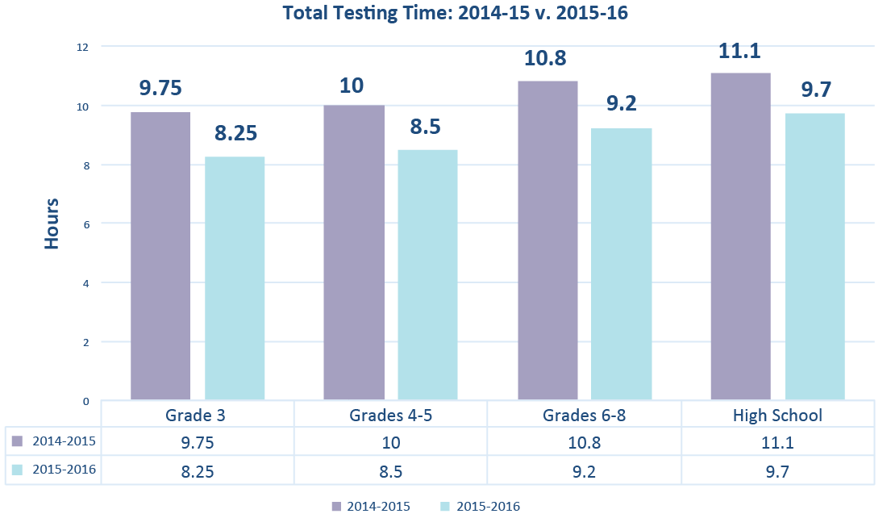
Test Design Changes - 90 Minute Reduction
Overall times include Reading/Writing and Mathematics across all test units per grade
Notes:
Not only is there one testing window; the overall testing times for each grade level are shorter by 90 minutes.

Slide 8
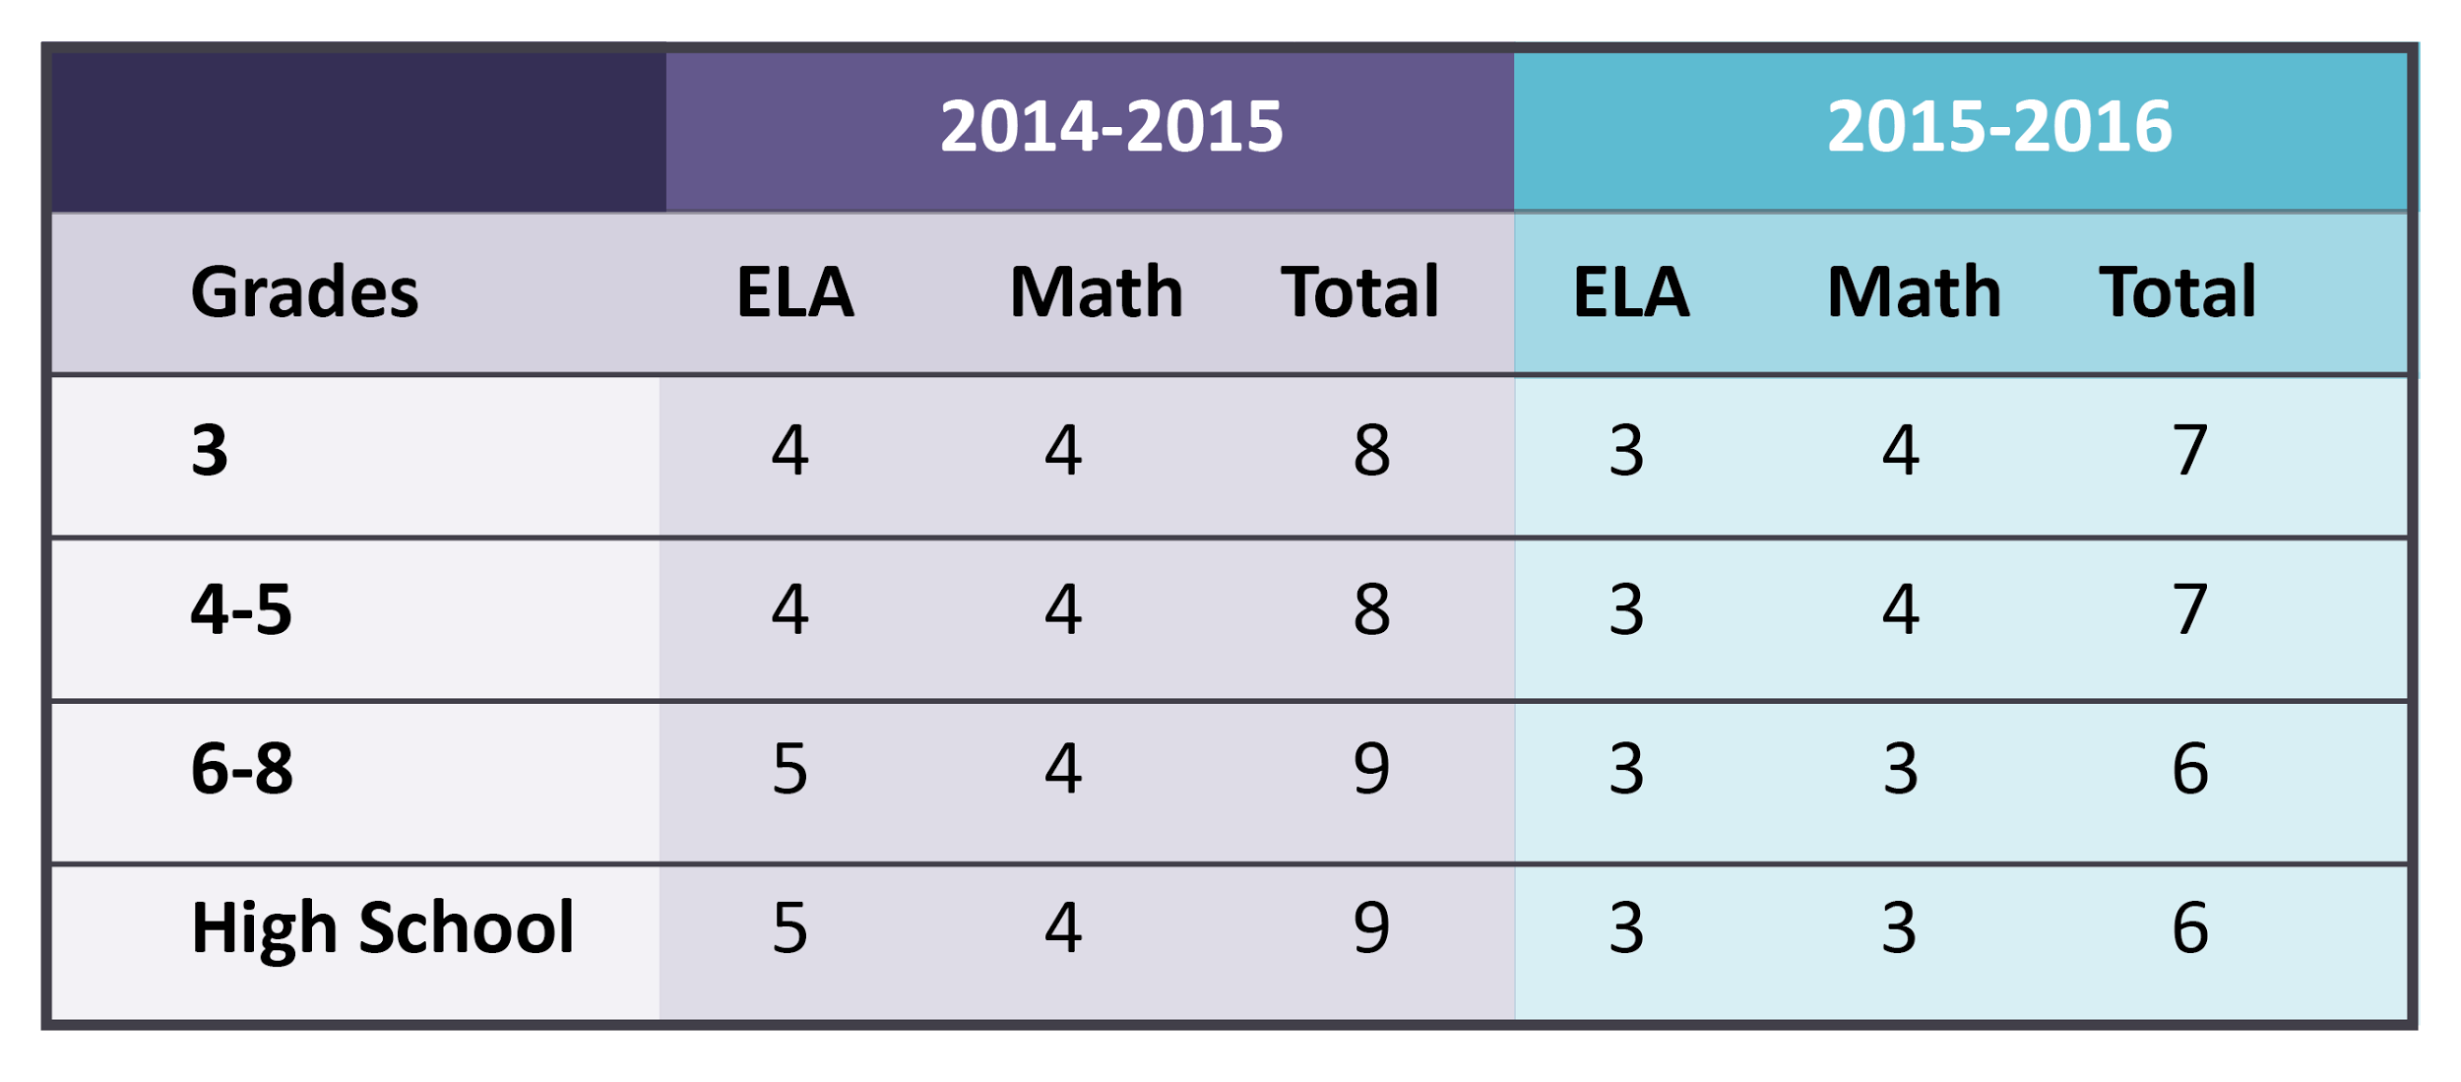
Test Design Changes – Fewer Test Units
With the changes, students in all grades will participate in fewer test units.
The redesigned ELA/L tests are composed of 3 units. The math tests are composed of 3 or 4 units.
Notes:
The reason the overall testing time is shorter is because there are less units—students still have the necessary time to complete their tests.

Slide 9
Unit Testing Times
Grade 3
ELA Unit 1: 90 minutes
ELA Unit 2: 75 Minutes
ELA Unit 3: 90 Minutes
Grades 4 and 5
ELA Unit 1: 90 Minutes
ELA Unit 2: 90 Minutes
ELA Unit 3: 90 Minutes
Grades 3-5
Math Units 1-4: 60 minutes each
Grades 6-8
ELA Unit 1: 110 minutes
ELA Unit 2: 110 Minutes
ELA Unit 3: 90 Minutes
Math Units 1-3: 80 Minutes Each
Grades 9-11
ELA Unit 1: 110 Minutes
ELA Unit 2: 110 Minutes
ELA Unit 3: 90 Minutes
Math Units 1-3: 90 Minutes Each
Notes:
The sessions with the same unit testing times (with the same number of minutes) can be combined.

Slide 10
The Score Report
http://www.parcconline.org/assessments/score-results

Slide 11
Score Release Timeline
STATE RELEASES
Some states: high Level preliminary results
States release state-level score results, approximately
September
October
November
December
States, vendor quality control reviews, prepare score results
Districts receive HS score reports
Districts receive 3-8 score reports
MILESTONES
Notes:
The state score reports have been released. The district score reports are supposed to be released in mid November (very soon). The student individual score reports are supposed to be released in late December (before the Holiday Break).

Slide 12
About the Score Reports…
The PARCC tests replace the old state tests. They measure how well students are performing against the new state standards that guide math and English language arts instruction.
The PARCC tests are only one of several measures, including report card grades and in-class performance, that are used to determine a student's academic achievement. They do not impact a student’s GPA.
The score reports are a valuable tool for parents and teachers. The report provides a deeper level of information that can be used to better understand where students are doing well and where they need additional support. This helps teachers and parents support students.
Notes:
It’s important to remember that we have always assessed students in regard to the state standards and that the information and data we receive—along with every other assessment we give—is meant to guide instruction—to help identify student strengths and weaknesses and adjust instruction. The reports are released much later this year than they will normally be released. The goal is a 42-day turn around.

Slide 13
Five Performance Levels
Five Performance Levels
PARCC uses five performance levels that delineate the knowledge, skills, and practices students are able to demonstrate:
Place a purple frame around images
Level 1:
Did Not Yet Meet Expectations
Level 2: Partially Met Expectations
Level 3: Approached Expectations
Level 4: Met Expectations
Level 5: Exceeded Expectations
Notes:
PARCC uses 5 performance levels.

Slide 14
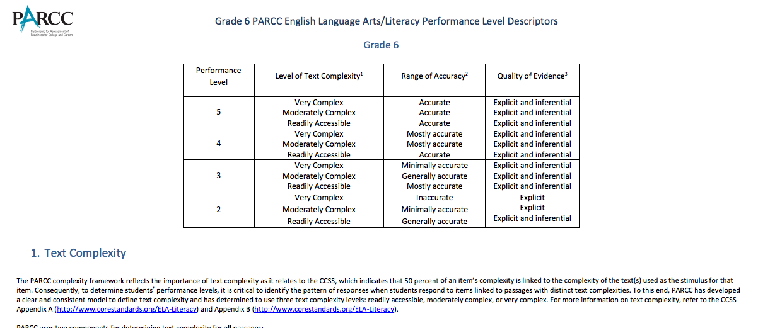
Use Performance Level Descriptors:
Notes:
Each item has a descriptor for each performance level. This example of a descriptor is for a sixth grade ELA item that focuses on text complexity and how the student performs in relation to text complexity. Performance Level Descriptors (PLD’s) can be found on the PARCC resources page/PARCC website

Slide 15
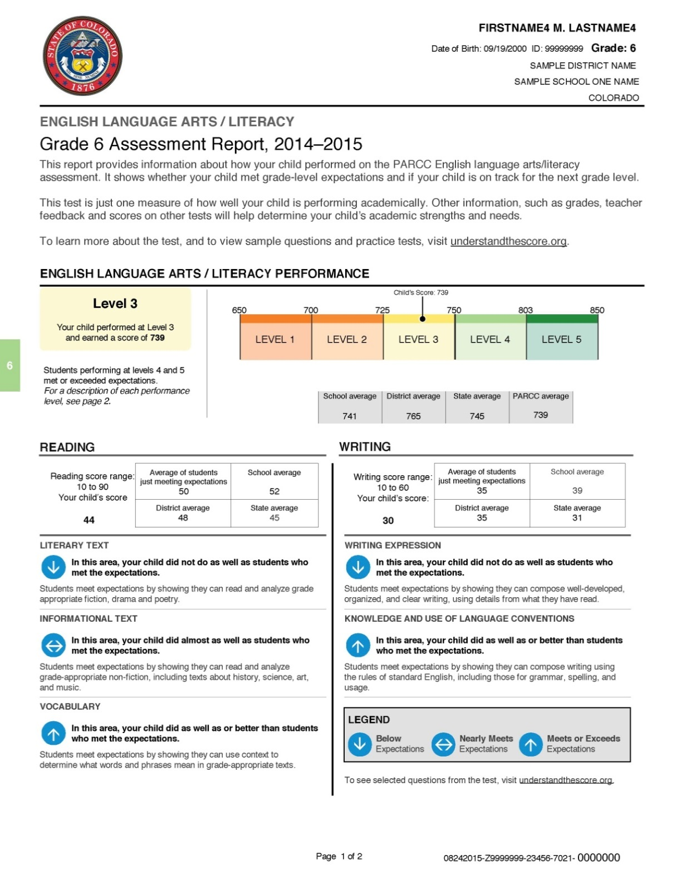
Score Reports
Notes:
This is what the front of the students’ individual score reports will look like…except it will not have the different colors. Everything will be in blue (like the previous slide)

Slide 16
Score Reports
Is the student meeting grade level expectations?
What does this data say about the student?
Notes:
There are two questions we should be asking. Is the student meeting grade level expectations? And what can we learn from the data?

Slide 17
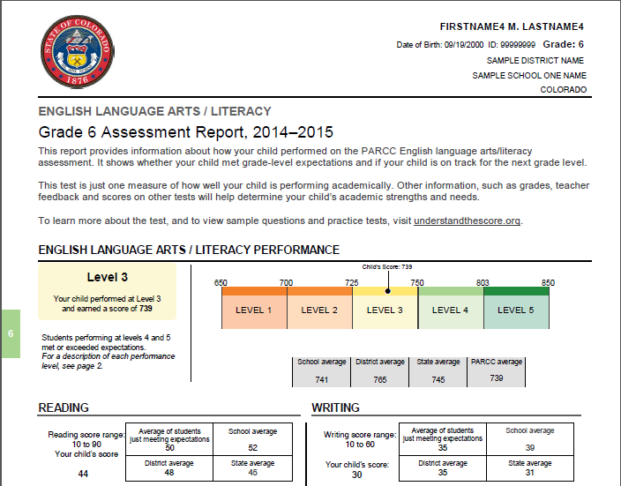
Individual Student Report: ELA/L
Notes:
One of the differences besides the 5 performance levels is the comparison of the student’s score to the school, district, state, and PARCC averages. THE ELA score will also have a separate scoring grid for reading and writing. These grids give a scoring range, the average of the students who were just meeting expectations, the school, district, and state averages. It is important to know that these separate grids do not “add up to” the student’s total score. They are an entirely different score unto themselves.

Slide 18
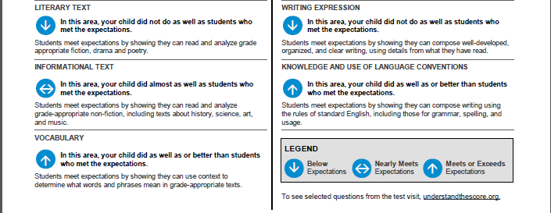
Individual Student Report: ELA/L
Notes:
Below the upper grids are the disaggregated scores measured with arrows that indicate whether or not the student did as well, almost as well, or not as well, as other students. Please notice that all scores are based on what other students have done. The scores are comparative or norm-referenced. The scoring will not be criterion referenced until the cut scores are created (this summer).

Slide 19
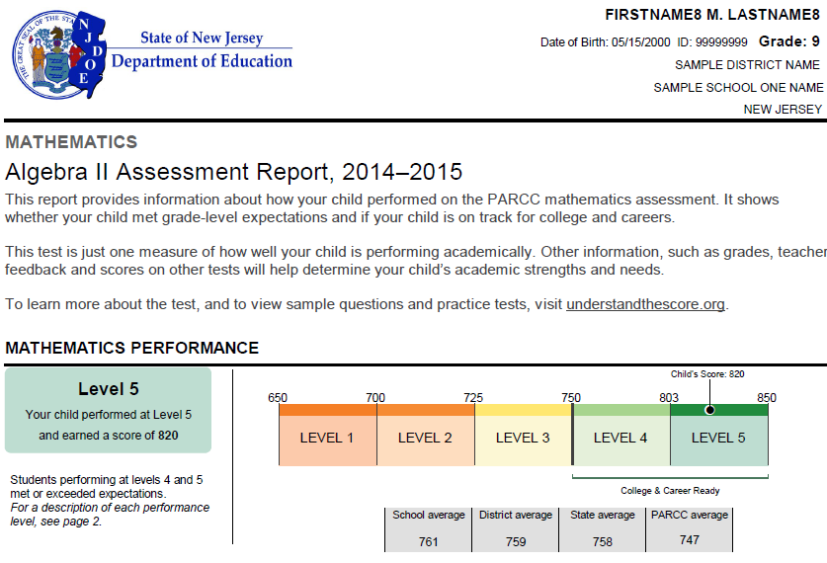
Individual Student Report: Math
Individual Student Report: Math
Notes:
This is an Algebra II Individual Score report

Slide 20
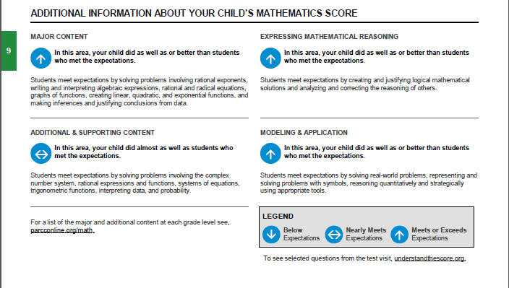
Individual Student Report: Mathematics
Notes:
The Math Scores are disaggregated differently. They are based on Major Content which is what you would see as a math book chapter (example: ratios). The additional or supporting content which is categories within the chapters (example: creating an expression that shows a ratio). Expressing Mathematical Reasoning is the explanation behind the mathematical problem. Modeling and Application is creating a “real-world” application (or solving one) involving mathematics.

Slide 21
Score Reports
Notes:
On the back of the individual score reports the parents are told to “start a discussion with your child’s teacher” and If the results are different than you expected, “meet with your child’s teacher to understand what that means”

Slide 22
^{Draft}
^{School}
^{Report}
How are our students progressing?
How do our students compare?
Do the results align with our other assessments?
Notes:
When the district and school reports come out, they are supposed to look much like student reports. We will be able to see each grade level and how the scores are distributed across performance levels and compare with each other. The growth columns should not be filled in because the data is in year 1- so there is no growth yet. It will state how many students tested, the average performance level and the average student score. There is also a filter where we are supposed to be able to disaggregate the data and a download option to download the data into an excel/csv. file

Slide 23
tudent Roster Report (Sub-Scores)
What trends can be discerned from the data?
¹⁰
Notes:
When we filter the scores by item analysis, we see the student, the student’s score and the disaggregated content. We can identify trends

Slide 24
^{Draft}
^{of}
^{Student}
^{Roster}
^{Report}
^{(Item}
^{Scores)}
What are student’s strengths and weaknesses?
¹¹
Notes:
We are also supposed to be able to click on the items and get a description of the reposnse and item

Slide 25
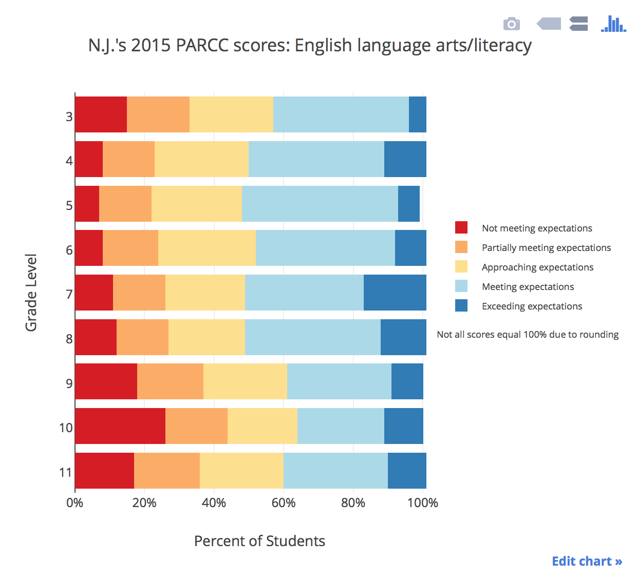
Notes:
These are our actual ELA State scores

Slide 26
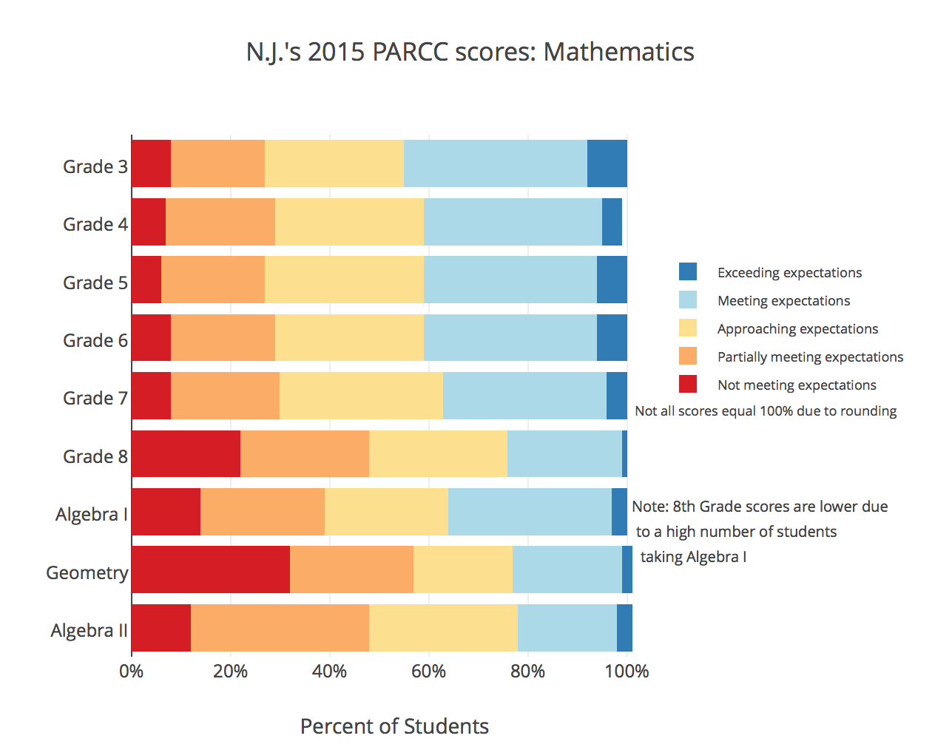
Notes:
These are our actual State Math Scores

Slide 27
More Questions to Ask When I Get My Results
What strengths/weakness exist in curriculum / instruction?
What additional professional resources are needed?
How can this inform PLCs?
Notes:
It’s this type of analysis that will allow us to identify the strengths and weaknesses in the curriculum, identify where we need resources, and can lead to great PLC discussions

Slide 28
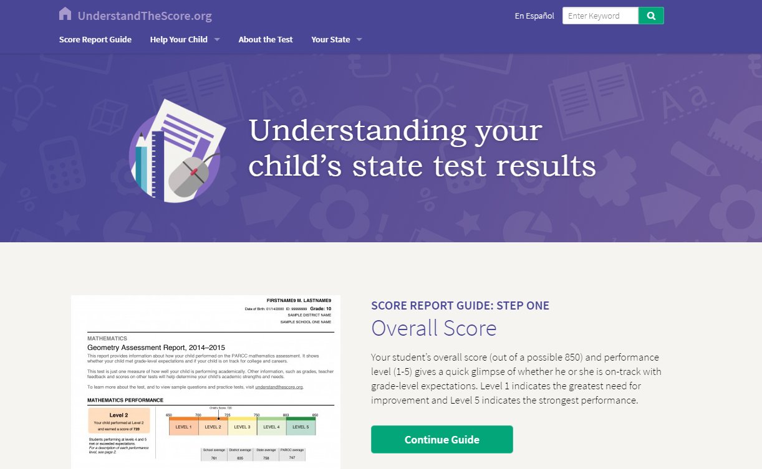
UnderstandTheScore.org
Notes:
One of the best resources for understanding the score.

Slide 29
Quick Look at Score Reports
“A Look at PARCC Reports that Parents and Districts Will Receive” with presentation notes, is at: http://www.state.nj.us/education/assessment/symposium/
Note: No real student data is presented.
All assessments should inform student learning!
Notes:
Don’t ignore the resources at DOE and of course PARCC

Slide 30
Questions?
Questions?

